Slide 1
Power Analysis for Blood Pressure
Sanil

Slide 2
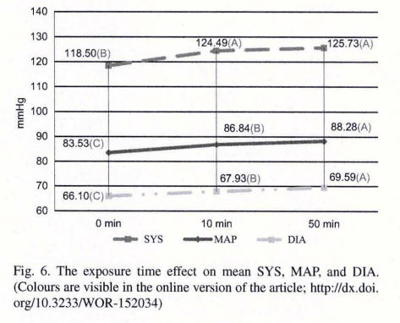
Literature Effect of
Based on this study, we expect to see an
increase of 7.2 mmHg for Systolic BP,
Increase of 4.2 mmHg for MAP,
Increase of 3.4 mmHg for Diastolic BP

Slide 3
Noise of Machine
Tested Markos blood pressure n=13 times with 1 minute in between, variance of 3.2 for mean arterial pressure (MAP)
Diastolic blood pressure measured a variance of 3.19
Systolic blood pressure measured a variance of 12.69
From these values, we decided to use MAP, because it incorporates both values and also has a variance(noise of machine measurement) less than the expected increase in blood pressure.

Slide 4
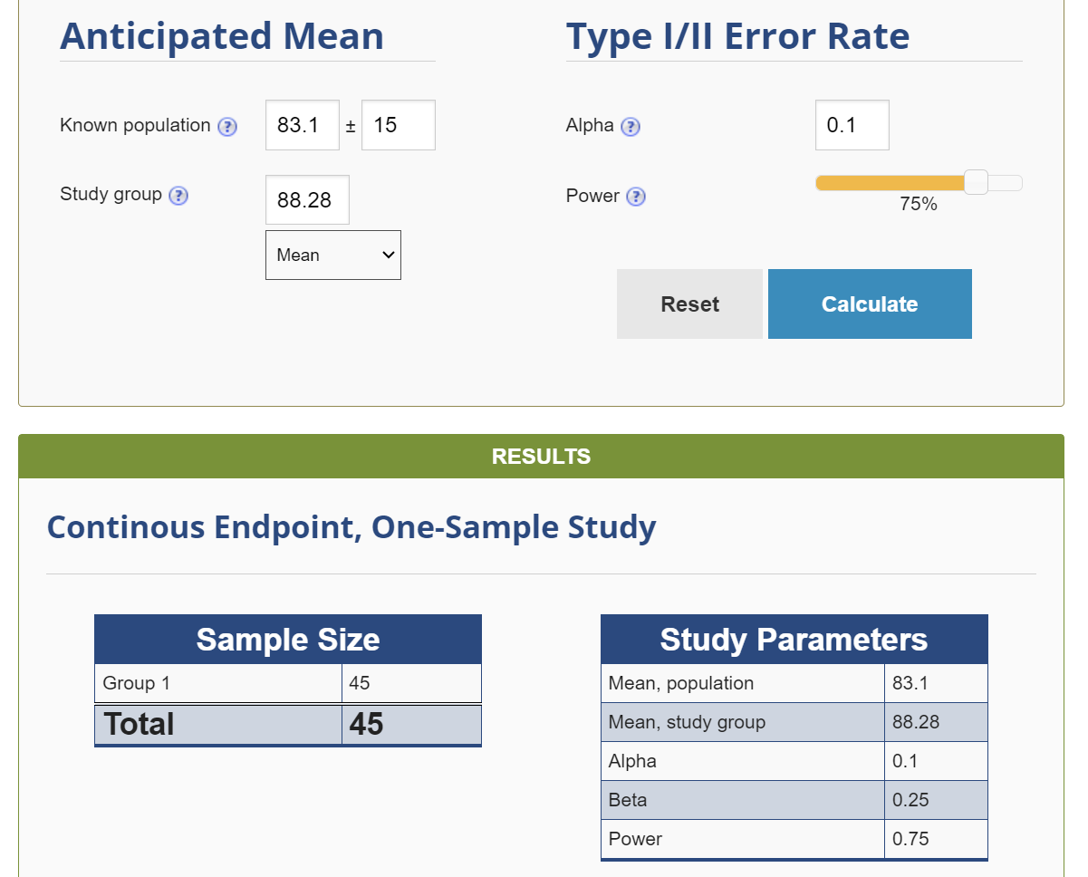
Power Analysis
Using a type 1 error rate of 0.1
Using type 2 error rate of 0.25
(slightly higher than standard for both)
Power analysis revealed that we will
need 45 participants to see the
difference in mean arterial pressure
from noise stimulus

Slide 5
Work Cited
https://content.ebscohost.com/cds/retrieve?content=AQICAHjIloLM_J-oCztr2keYdV8f1ibHmDucods679W_YPnffAEg0poGpUagAlmG1ttjKe4yAAAA2zCB2AYJKoZIhvcNAQcGoIHKMIHHAgEAMIHBBgkqhkiG9w0BBwEwHgYJYIZIAWUDBAEuMBEEDMjovVzg8gWlL5E56wIBEICBk_ADE_J1CWFx2xOQxwYf5adiSfyitWsMjBPEdP7h8WQ5ptaDbWV7w9ewf5fRM5punJaOLTFoXq8CjycGWpWBOkt6qGIqE1qGokxMVKk_BIbRtW9paeGRn89H5qS7vRTlQGnaKg6QshgXhNMT6EEYxCGYP_PZ9_sHsWn6nlEfJ2ykk6LhsUblmFXif69vqM1XTBjTWA==

